Slide 1
Report on A6.6 Organization of Symposium for promoting WRM in WB
Maja Petrović
University of Novi Sad
23 June 2021
This project has been funded with support from the European Commission. This publication reflects the views only of the author, and the Commission cannot be held responsible for any use which may be made of the information contained therein.

Slide 2
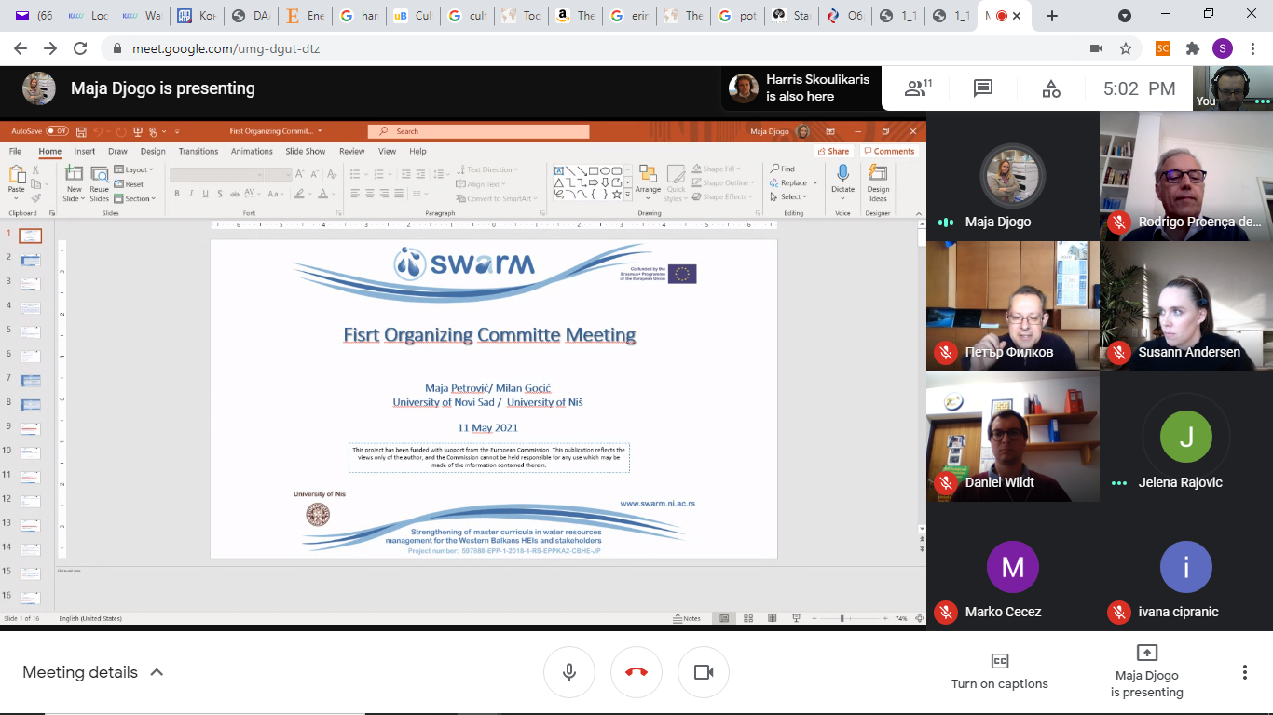
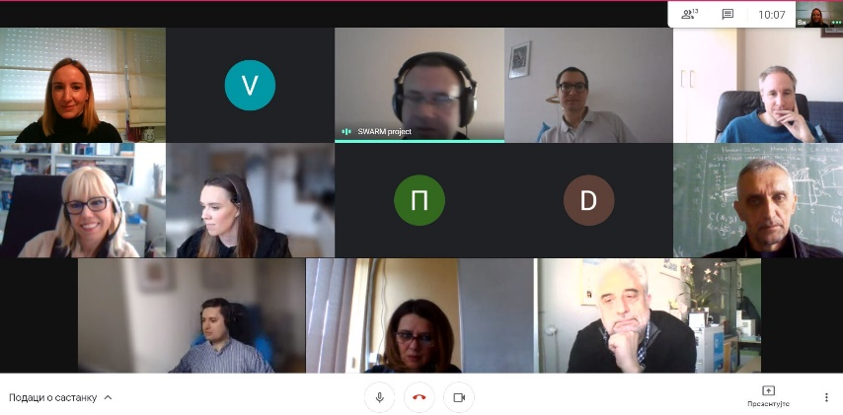
Organisation activities
Meeting related to the organization of Symposium for promoting WRM in WB – 16.03.2021.
First Scientific Committee Meeting – 28.04.2021.
First Organizing Committee Meeting – 11.05.2021.
Strengthening of master curricula in water resources management
for the Western Balkans HEIs and stakeholders
www.swarm.ni.ac.rs

Slide 3
SWARM Partner Institution | Scientific Committee | Organization Committee
P1 – University of Niš (UNI) | Slaviša Trajković | Milan Gocić
P2 - University of Natural Resources and Life Sciences, Vienna (BOKU) | Michael Tritthart | Daniel Wildt
P3 - Norwegian University of Life Sciences (NMBU) | Zakhar Maletskyi | Susann Andersen
P4 - Aristotle University of Thessaloniki (AUTh) | Panagiotis Prinos | Harris Skoulikaris
P5 - University of Architecture, Civil Engineering and Geodesy (UACEG) | Maria Mavrova | Petar Filkov
P6 - University of Rijeka, Faculty of Civil Engineering (UNIRIFCE) | Barbara Karleuša | Bojana Horvat
P7 – University of Lisboa (UL) | Maria Manuela Portela | Rodrigo Proença de Oliveira
P8 – University of Novi Sad (UNS) | Srđan Kolaković | Maja Petrović
P9 – University of Sarajevo (UNSA) | Emina Hadžić | Hata Milišić
P10 - Dzemal Bijedic University of Mostar (UNMO) | Mili Selimotić | Marko Ćećez
P11 - Unversity of Pristina in Kosovska Mitrovica (UPKM) | Jelena Đokić | Gordana Milentijević
P12 - Technical College of Applied Science Urosevac-Leposavic (TCASU) | Predrag Stanojević | Jelena Rajović
P13 - University of Montenegro (UoM) | Goran Sekulić | Ivana Ćipranić
P14 – Public Water Management Company “Vode Vojvodine” (PWMC VV) |  | Olivera Gavrilović
Strengthening of master curricula in water resources management
for the Western Balkans HEIs and stakeholders
www.swarm.ni.ac.rs

Slide 4
Title of the event
Water Resources Management:
new perspectives and innovative practices
Strengthening of master curricula in water resources management
for the Western Balkans HEIs and stakeholders
www.swarm.ni.ac.rs

Slide 5
Hybrid event
Online platform (ZOOM)
Live attendance at UNS
Strengthening of master curricula in water resources management
for the Western Balkans HEIs and stakeholders
www.swarm.ni.ac.rs

Slide 6
Prepared material
Liflet
Poster
Registration form (https://docs.google.com/forms/d/1XBIqs6zDOx6PA4dIvnqnEXLZLCNDSFpJIQvjQCDO-zk/edit)
Instructions for papers
ppt template
Certificate
Website (http://www.swarm.ni.ac.rs/symposium)

Slide 9
Work to do…
Activity | Deadline | NEW Deadline | Responisbility
FINAL Program | End of May | End of June | Milan Gocic
Announcement for Social networks | End of May | End of June | Maja Petrovic
Announcement for newspapers | End of May | End of June | Maja Petrovic
Sending invitations | 01 June – 31 July | 01 July – 31 July | All Project partners
Registration closure | 01 August | 10 August | Orginizing Committe
Notification of Acceptance | 20 August | 20 August | Scientific Committe
Deadline for Presentation Submission | 22 September | 22 September | Orginizing Committe

Slide 10
Event documentation
Symposium invitation (announcement)
Attendance list
Annex DE3 – Dissemination activity form
Photos
Video
Proceedings
Conclusions
Presentations
Report
Press release
Strengthening of master curricula in water resources management
for the Western Balkans HEIs and stakeholders
www.swarm.ni.ac.rs

